Slide 1


Artificial Intelligence and Machine Learning

Slide 2
1000kg
40mpg
3000kg
20mpg
?
2000kg

Slide 3
inputs
output
1000kg
40mpg
3000kg
20mpg
2000kg
30mpg

Slide 6
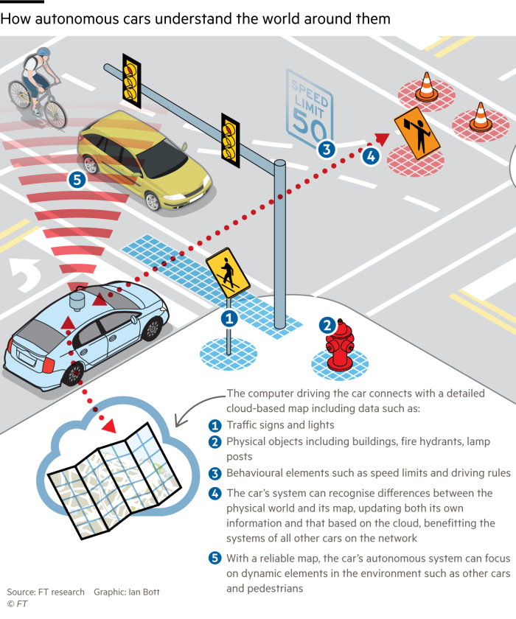
AI Example

Slide 7
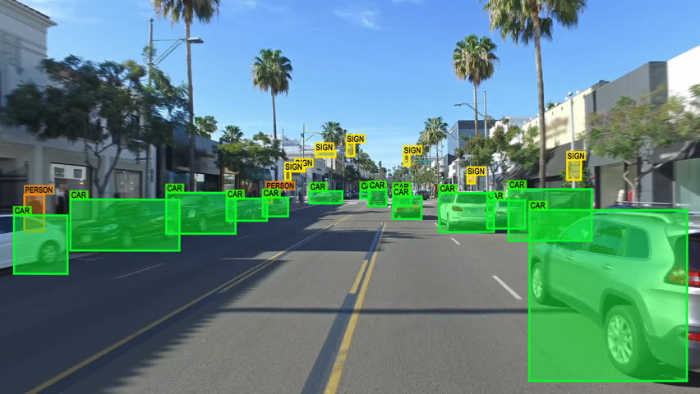
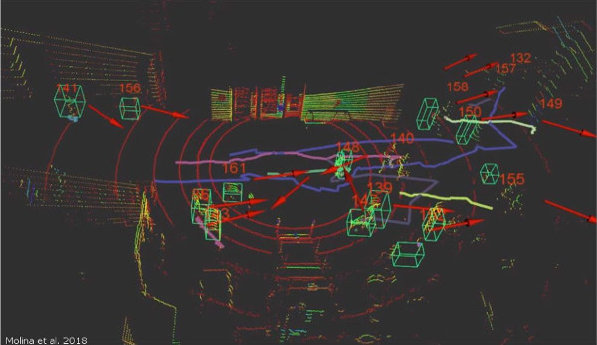
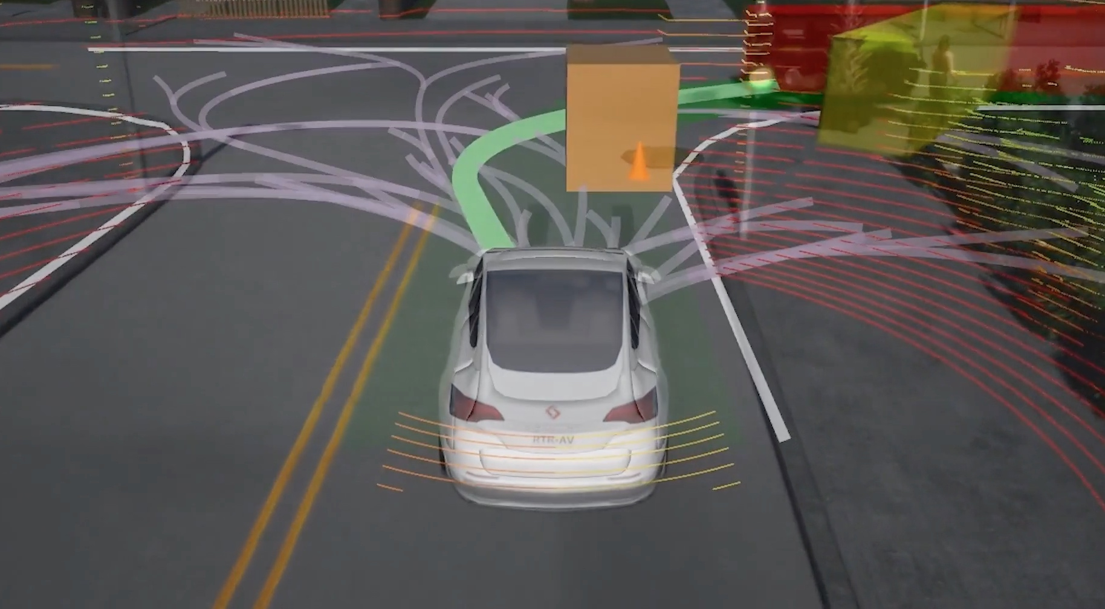
Perception Prediction Planning

Slide 8


Slide 9
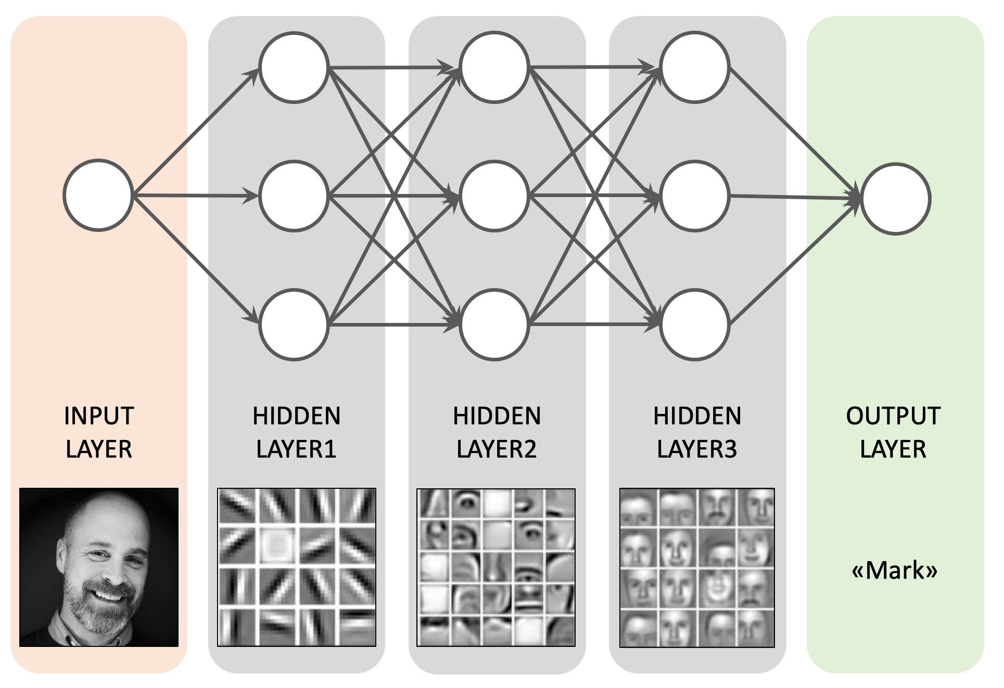
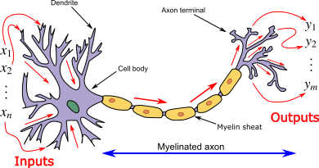
Deep Learning / Neural Networks

Slide 10
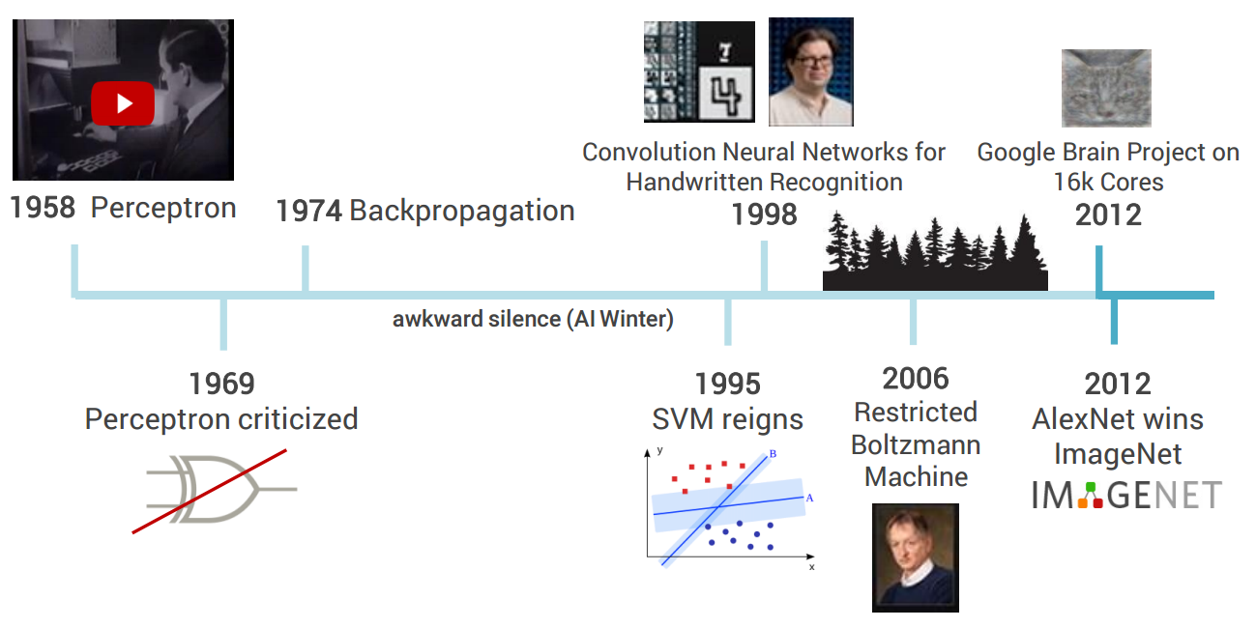
Deep Learning

Slide 11


Slide 12
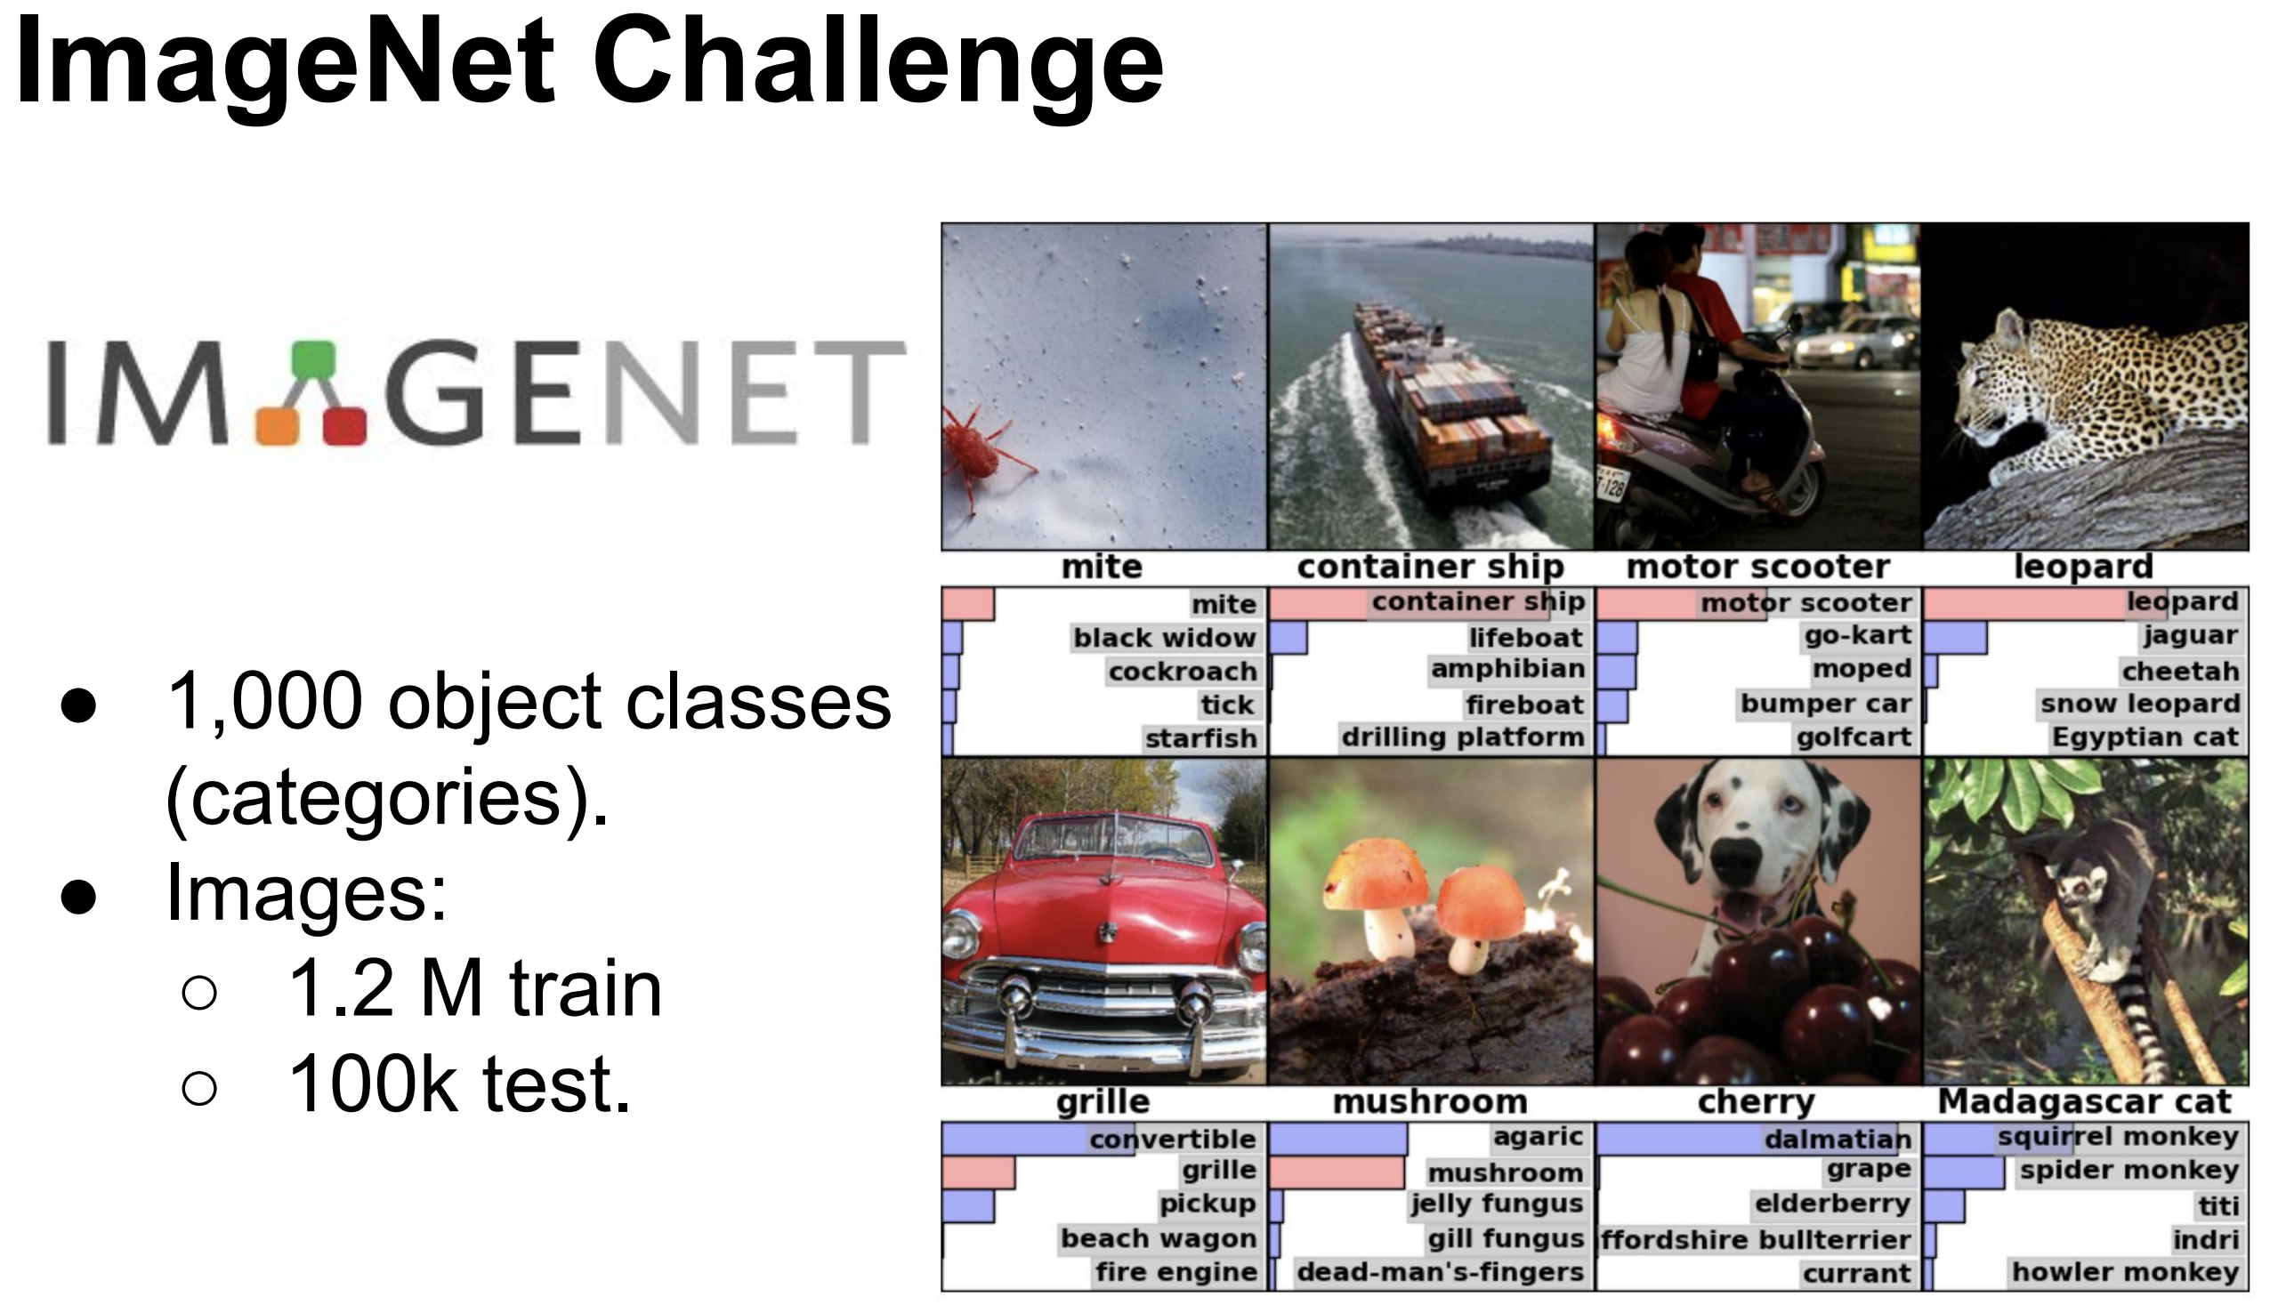
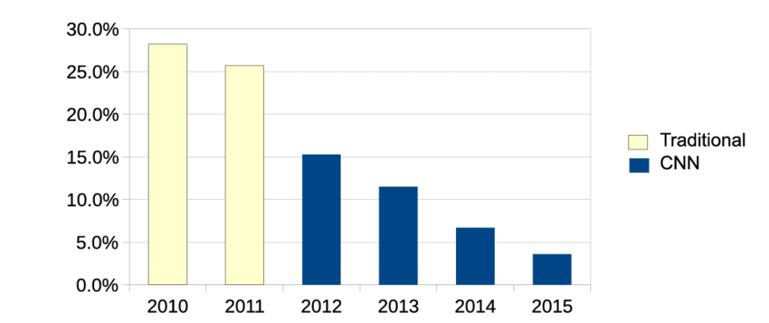
Imagenet

Slide 13

Neural Networks

Slide 14
Time for some Math

Slide 15



Fish and Chips
X 2
$12
X 1
X 1

Slide 16
Fish and Chips
X 2
$?
$?
$12
X 1
$?
X 1

Slide 17
Dataset
Fish | Chips | Sauce | Total
2 | 1 | 1 | $12
3 | 2 | 4 | $15
1 | 1 | 0 | $7
0 | 2 | 2 | $8
1 | 1 | 0 | $7

Slide 18
Linear Regression
X 2
$m₁
$m₂
+
$12
X 1
$m₃
X 1

Slide 19
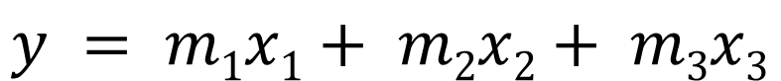

Linear Regression
x₁
$m₁
$m₂
$y
x₂
$m₃
x₃
$$y = m1x1+ m2x2+ m3x3$$

Slide 20
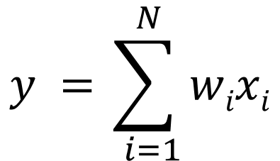
Linear Regression
x₁
w₁
w₂
y
x₂
w₃
x₃
$$y =\sum_{ i=1}^{ N}{wixi}$$

Slide 21
Fish and Chips
2
$3?
$10?
$27?
1
$7?
Error/Loss
1
$12

Slide 22
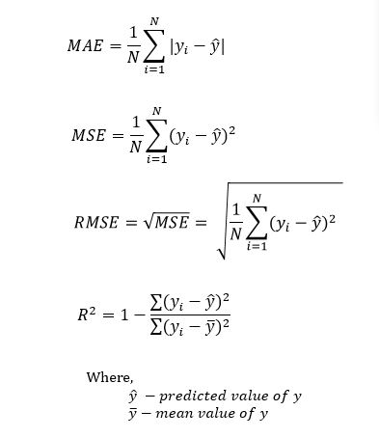
Loss Functions - Regression
$27?
Error/Loss
$12

Slide 23
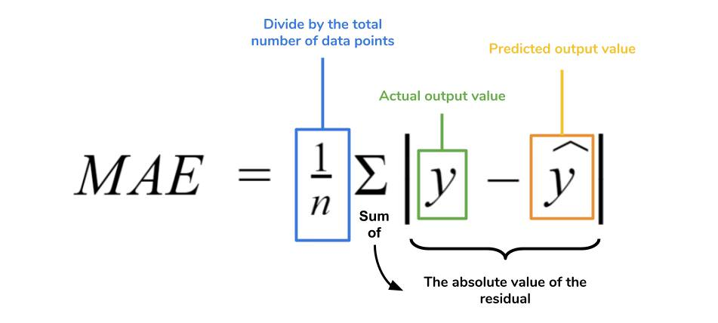
Error Metrics
$27?
Error/Loss
$12

Slide 24
Gradient descent
For each input feature and voting weight, adjust it up and down a bit and see how the error changes.
error
weight

Slide 25
Gradient descent
For each input feature and voting weight, adjust it up and down a bit and see how the error changes.
error
weight

Slide 26
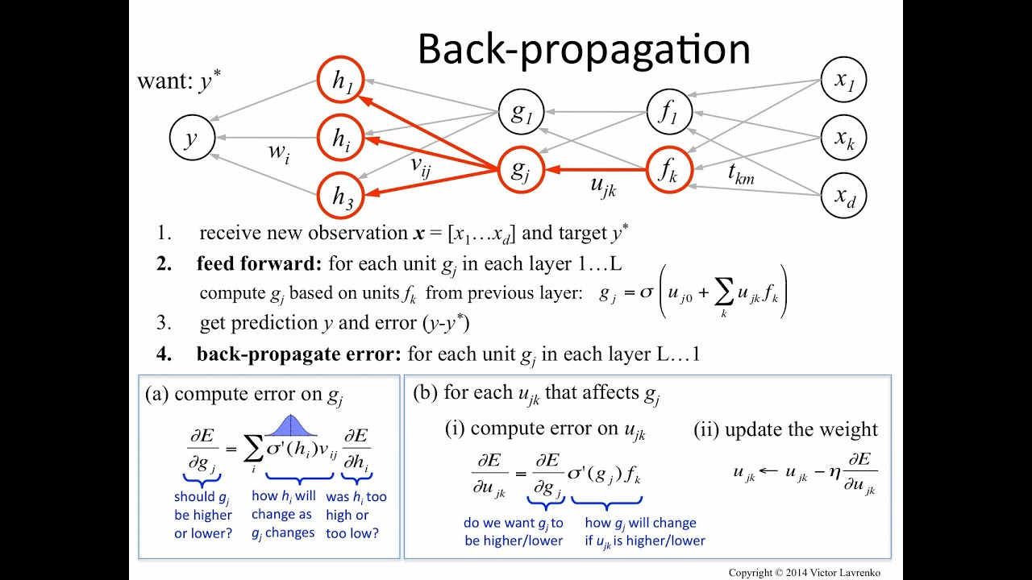
Gradient descent

Slide 27
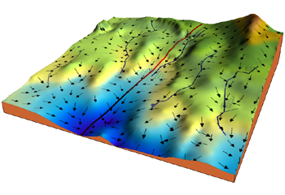
Gradient descent
error
weight

Slide 28
Weight Update
$$w^{new}=w^{old}+learning rate∗gradient$$
x₁
w₁
w₂
y
x₂
w₃
x₃

Slide 29
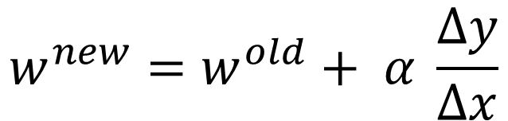
Weight Update
$$w^{new}=w^{old}+ α \frac{Δy}{Δx}$$
x₁
w₁
w₂
y
x₂
w₃
x₃

Slide 30

Learning Rate
error
error
error
w
w
w
Notes:
https://distill.pub/2017/momentum/

Slide 31

Learning Rate

Slide 32

Different Optimizers

Slide 33
Gradient descent
error
weight

Slide 34
Fish and Chips
2
$5?
$10?
$27?
1
$7?
Error/Loss
1
$12

Slide 35
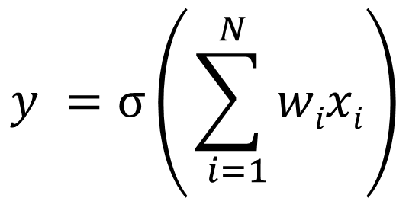


Neuron
x₁
w₁
w₂
x₂
$σ$
y
w₃
x₃
$$y =σ\left(\sum_{ i=1}^{ N}{wixi}\right)$$

Slide 36
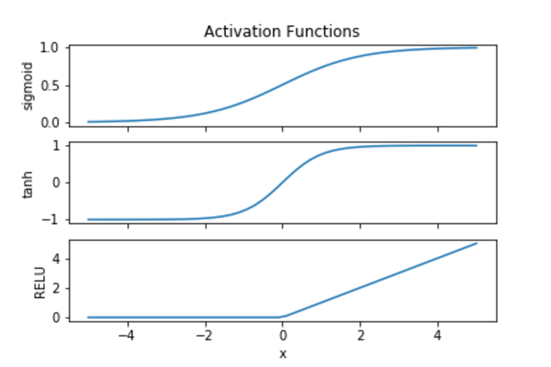
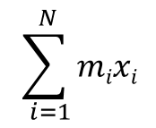
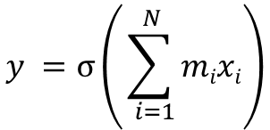
$$σ$$
$$y =σ\left(\sum_{ i=1}^{ N}{mixi}\right)$$
$$\sum_{ i=1}^{ N}{mixi}$$

Slide 37
Neuron
x₁
w₁
w₂
x₂
$σ$
y
w₃
x₃
$$y =σ\left(\sum_{ i=1}^{ N}{wixi}\right)$$

Slide 38
Neuron
x₁
w₁
w₂
x₂
$σ$
y
w₃
x₃

Slide 39
Neuron
x₁
x₂
y
x₃

Slide 40
Neural Network
x₁
x₂
y
x₃
Notes:
https://playground.tensorflow.org/

Slide 41
Neural Networks

Slide 42

Can only deal with numbers

Slide 43
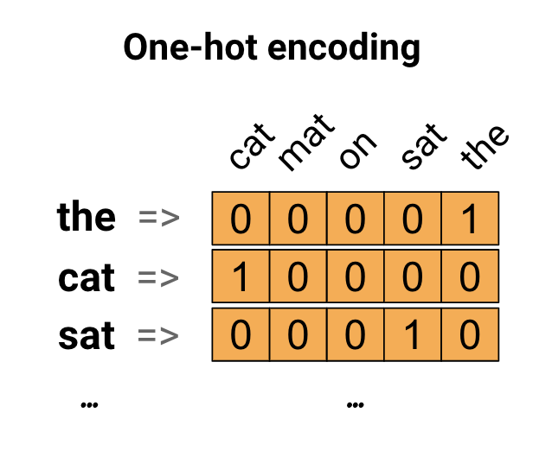
The Cat sat on the Mat

Slide 44
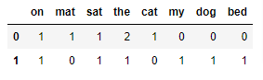
The Cat sat on the Mat
The Dog sat on my bed

Slide 45
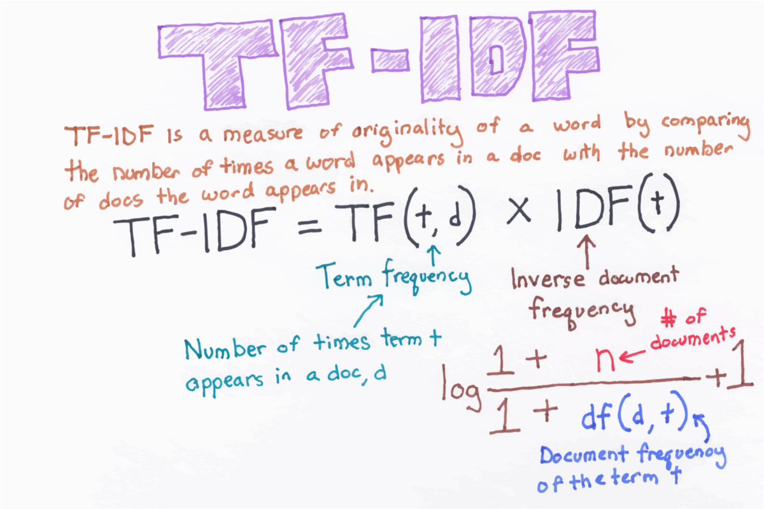
TFIDF
Rather than just counting, we can use the TF-IDF score of a word to rank it's importance.

Slide 46
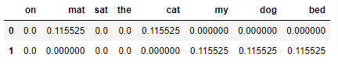
TFIDF
The Cat sat on the Mat
The Dog sat on my bed
The Cat sat on the Mat
The Dog sat on my bed

Slide 47
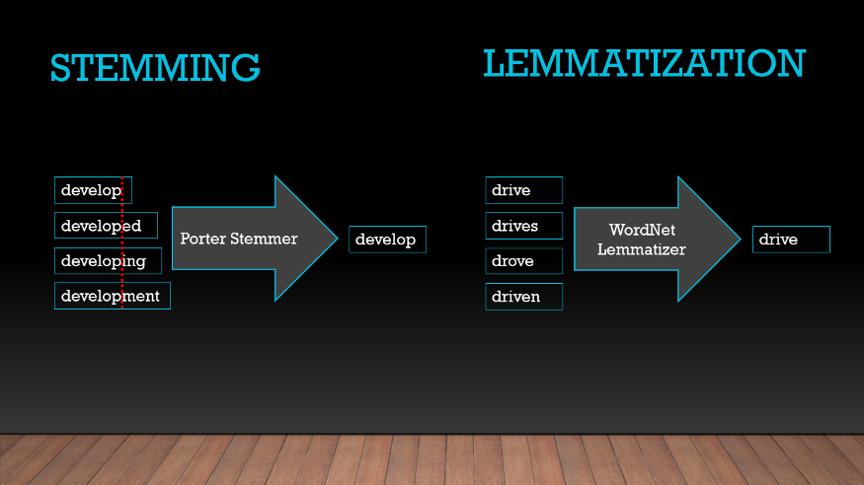
Other NLP techniques

Slide 48
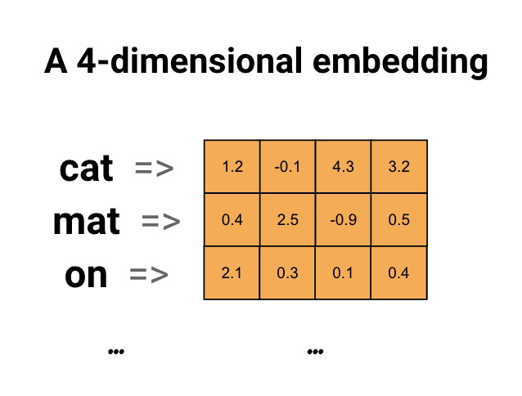
The Cat sat on the Mat

Slide 49

Word Embeddings

Slide 50
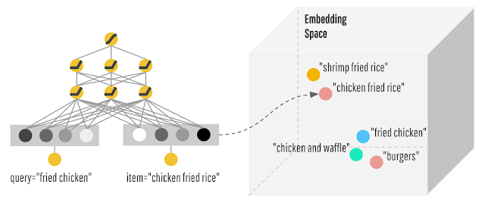
Word Embeddings

Slide 51
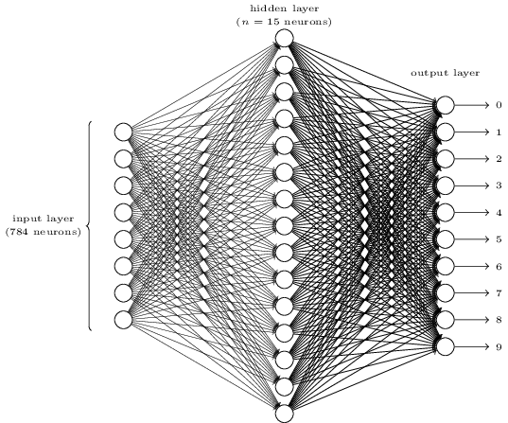
Let’s build a ML Model

Slide 52
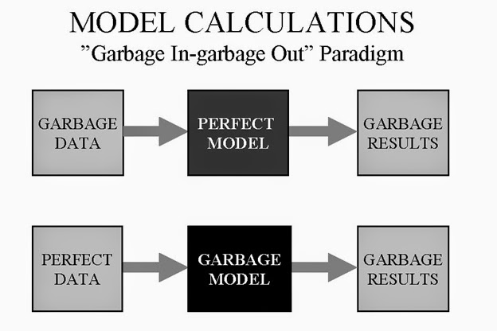
Training testing and validation
Training data
The data your algorithm will ‘learn’ from.
garbage in = garbage out.
Validation data
Data used to tune hyperparameters.
Results will be used to tweak the model.
Testing data
Used to validate final accuracy.
Should not be used for hyperparameter tuning.

Slide 53
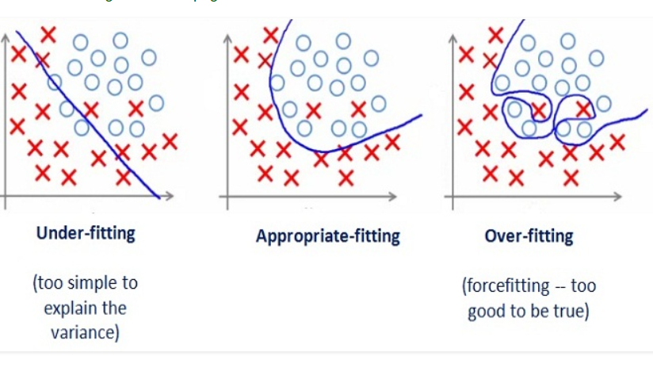
Overfitting/Underfitting

Slide 54
Overfitting

Slide 55
Resources
Youtube
http://3b1b.co/neural-networks
https://www.youtube.com/playlist?list=PLZbbT5o_s2xq7LwI2y8_QtvuXZedL6tQU
https://www.youtube.com/watch?v=JB8T_zN7ZC0
… + a LOT more
MOOCs
fast.ai
deeplearning.ai
http://cs231n.stanford.edu

